Slide 1
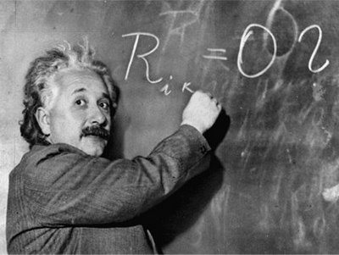
Unit 1: Trade Theory
Standard Trade Model
2/6/2012

Slide 2
Definitions
indifference curve –
combinations of cloth & food that leave the consumer equally well off (indifferent)

Slide 3
Definitions
terms of trade –
price of exports relative to
the price of imports
(home: P_{C}/P_{F}; foreign: P_{F}/P_{C})

Slide 4
Definitions
biased growth –
occurs in one sector more than others causing RS to change

Slide 5
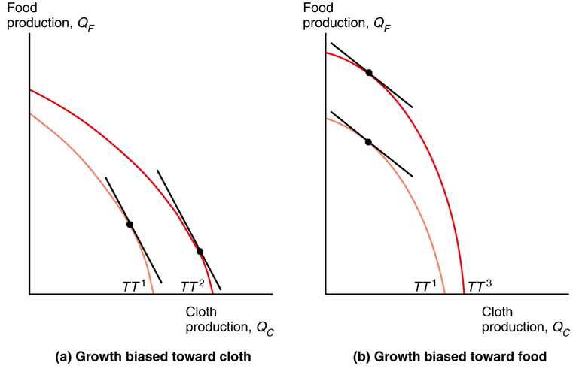
Definitions
export-biased growth –
expands a country’s PPF disproportionately in that country’s export sector
import-biased growth –
expands a country’s PPF disproportionately in that country’s import sector
Fig. 6-6: Biased Growth

Slide 6
Definitions
immiserizing growth –
export biased growth worsens terms of trade so much that country would be better off if it hadn’t grown at all

Slide 7
Definitions
import tariff –
tax levied on imports
export subsidy –
payments given to domestic producers that export

Slide 8
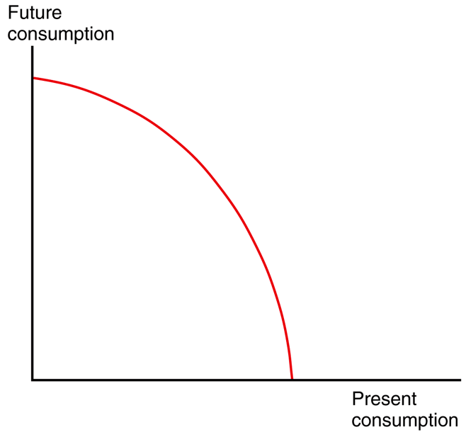
Definitions
Fig. 6-10: Intertemporal Production Possibility Frontier
intertemporal production possibility frontier –
maximum possible mixes of current output & future output

Slide 9
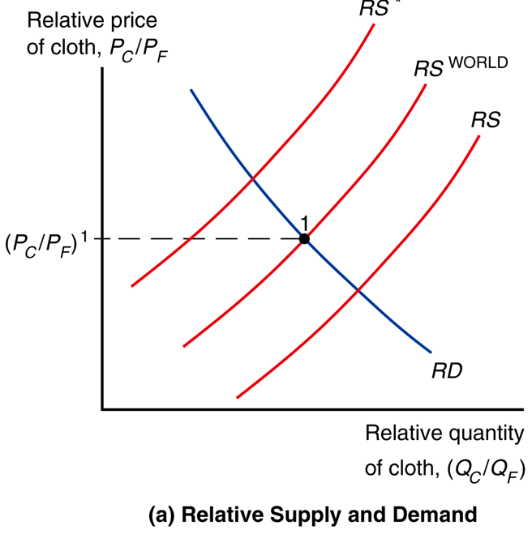
Standard Trade Model
Fig. 6-5a: Equilibrium Relative Price with Trade and Associated Trade Flows
Standard trade model is a general model that includes Ricardian, specific factors, and Heckscher-Ohlin models as special cases.

Slide 10
Standard Trade: assumptions
2 countries: home & foreign.
2 goods: cloth & food.
Each country’s PPF is a smooth curve.
PPF based on labor, capital, land, & technology.
A country’s PPF determines its relative supply function.
National RS functions determine a world RS function.
RS^{W} & RD^{W} determine international trade equilibrium.

Slide 11
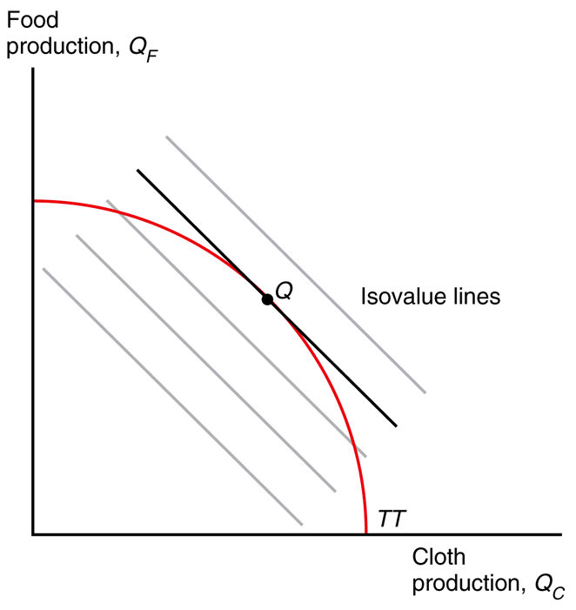
Standard Trade: relative supply
Fig. 6-1: Relative Prices Determine
the Economy’s Output
V = P_{C}Q_{C} + P_{F}Q_{F}
V ≡ total value
Q_{C} ≡ output of cloth
Q_{F} ≡ output of food
P_{C} ≡ price of cloth
P_{F} ≡ price of food
Slope is -P_{C}/P_{F}

Slide 12
Standard Trade: relative supply
Fig. 6-1: Relative Prices Determine
the Economy’s Output
Economy maximizes value constrained by the PPF.
So it produces at point Q where an isovalue line is tangent with the PPF.

Slide 13
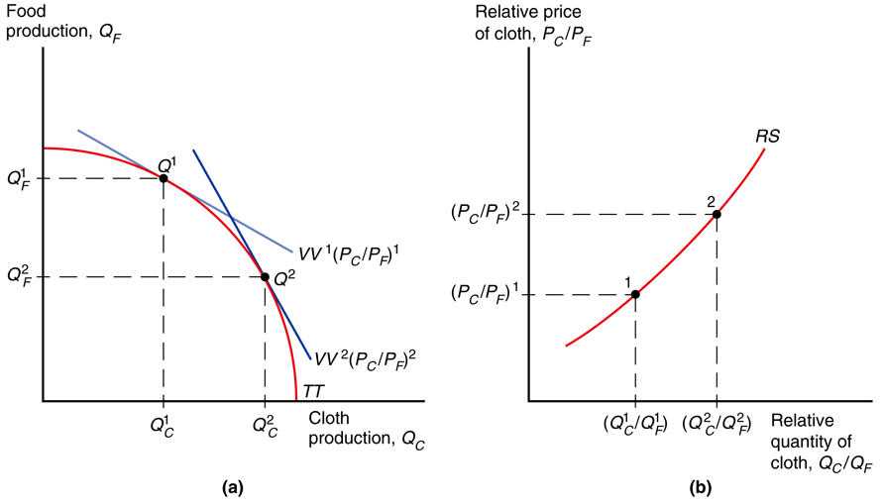
Standard Trade: relative supply
Fig. 6-2: How an Increase in the Relative Price of Cloth Affects Relative Supply
Increasing the relative price of cloth makes the isovalue line steeper, changing production mix.
Determining the mix of cloth to food production at each price ratio derives the relative supply curve.

Slide 14
Standard Trade: relative supply
Fig. 6-2: How an Increase in the Relative Price of Cloth Affects Relative Supply
As P_{C}/P_{F} rises, Q_{C}/Q_{F} rises. This makes the RS curve upward sloping.
Graphs (a) and (b) show production at two different PC/PF ratios.

Slide 15
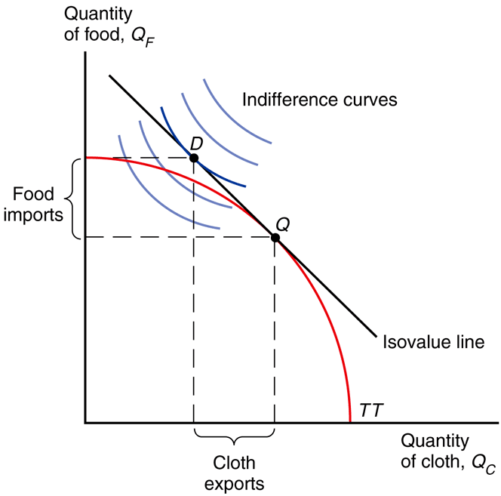
Standard Trade: relative demand
Fig. 6-3: Production, Consumption, and Trade in the Standard Model
V = P_{C}D_{C} + P_{F}D_{F} = P_{C}Q_{C} + P_{F}Q_{F}
D_{C} ≡ consumption of cloth
D_{F} ≡ consumption of food
Q_{C} ≡ production of cloth
Q_{F} ≡ production of food
P_{C} ≡ price of cloth
P_{F} ≡ price of food
Slope is -P_{C}/P_{F}

Slide 16
Standard Trade: relative demand
Fig. 6-3: Production, Consumption, and Trade in the Standard Model
Assume the economy’s consumption decisions
may be represented as if they were based on the tastes of a single representative consumer
(changing income distribution doesn’t change demand).

Slide 17
Standard Trade: relative demand
indifference curve –
combinations of cloth & food that leave the consumer equally well off (indifferent)

Slide 18
Standard Trade: relative demand
Fig. 6-3: Production, Consumption, and Trade in the Standard Model
Indifference curve properties
downward sloping
less cloth needs more food
for equal satisfaction
more is better
more cloth or food better
further from origin better
diminishing marginal substitution
extra cloth unit less valuable
convex to origin

Slide 19
Standard Trade: relative demand
Fig. 6-3: Production, Consumption, and Trade in the Standard Model
Without trade:
Produce/consume where indifference curve is tangent to PPF.
With trade:
Consume where indifference curve is tangent to isovalue line.
Produce where isovalue line
is tangent to PPF.
Export/import to get from Q to D.

Slide 20
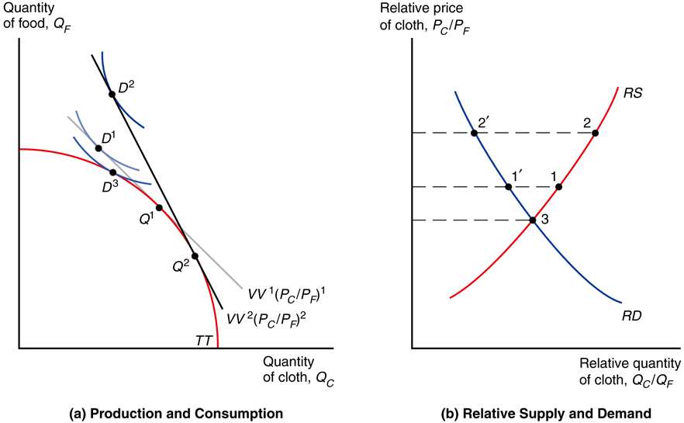
Standard Trade: relative demand
As P_{C}/P_{F} rises, D_{C}/D_{F} falls. This makes the RD
curve downward sloping.
Here at a P_{C}/P_{F} higher than the intersection of RS & RD, the economy will supply more cloth than demand: export cloth & import food.
Fig. 6-4: Effects of a Rise in the Relative Price
of Cloth and Gains from Trade

Slide 21
Standard Trade: relative demand
Fig. 6-4: Effects of a Rise in the Relative Price
of Cloth and Gains from Trade
Higher P_{C}/P_{F} makes the isovalue line steeper, which here leads to a higher indifference curve.
(Import more per export.)
An economy that
exports cloth is better
off when P_{C}/P_{F} rises.

Slide 22
Standard Trade: terms of trade
terms of trade –
price of exports relative to
the price of imports
(home: P_{C}/P_{F}; foreign: P_{F}/P_{C})
A rise in terms of trade
increases a country’s welfare.
A decline in terms of trade
decreases a country’s welfare.

Slide 23
Standard Trade: terms of trade
P_{C}D_{C} + P_{F}D_{F} = P_{C}Q_{C} + P_{F}Q_{F}
(D_{F} – Q_{F}) = (P_{C}/P_{F})(Q_{C} – D_{C})
(D_{F} – Q_{F}) ≡ imports of food
(Q_{C} – D_{C}) ≡ exports of cloth
(P_{C}/P_{F}) ≡ terms of trade
Higher price of exports means country can afford more imports.

Slide 24
Standard Trade: relative prices
Fig. 6-5a: Equilibrium Relative Price with Trade and Associated Trade Flows
The intersection of RS^{W} & RD^{W} determines relative prices.
RS^{W} is the ratio of the sum of country productions:
(Q_{C} + Q_{C}*)/(Q_{F} + Q_{F}*)
RD^{W} is the ratio of the sum of country consumptions:
(D_{C} + D_{C}*)/(D_{F} + D_{F}*)

Slide 25
Standard Trade: relative prices
Fig. 6-5a: Equilibrium Relative Price with Trade and Associated Trade Flows
RS is to the right of RS* because in this example
we assume Q_{C}/Q_{F} > Q_{C}*/Q_{F}*.
RS^{W} is between RS & RS*.
RD^{W} overlaps RD & RD*
because there are no differences in preferences.

Slide 26
Standard Trade: relative prices
Fig. 6-5a: Equilibrium Relative Price with Trade and Associated Trade Flows
At RS^{W} intersect RD^{W} (P_{C}/P_{F})¹
home’s RS (Q_{C}/Q_{F}) exceeds
home’s RD (D_{C}/D_{F}), so home exports cloth & imports food.
At RS^{W} intersect RD^{W} (P_{C}/P_{F})¹
foreign’s RD (D_{C}/D_{F}) exceeds
foreign’s RS (Q_{C}/Q_{F}), so foreign exports food & imports cloth.

Slide 27
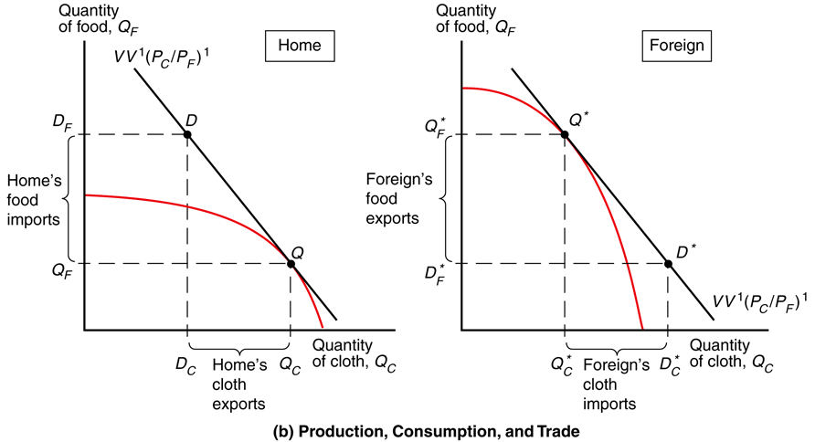
Standard Trade: relative prices
Fig. 6-5b: Equilibrium Relative Price with Trade and Associated Trade Flows
The amount of exports and imports for each country are made clear in the PPF diagrams.

Slide 28
Standard Trade: economic growth
Is growth in other countries good or bad for the U.S. standard of living?
Is growth in a country more or less valuable when part of a closely integrated world economy?

Slide 29
Standard Trade: economic growth
biased growth –
occurs in one sector more than others causing RS to change
Ricardian model:
technological progress in
one sector causes biased growth
Heckscher-Ohlin model:
increase in one factor of production causes biased growth

Slide 30
Standard Trade: economic growth
export-biased growth –
expands a country’s PPF disproportionately in that country’s export sector
import-biased growth –
expands a country’s PPF disproportionately in that country’s import sector
Fig. 6-6: Biased Growth

Slide 31
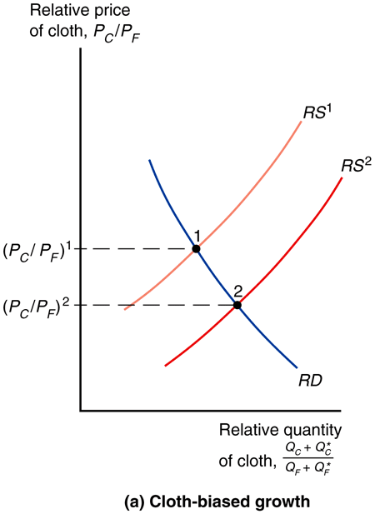
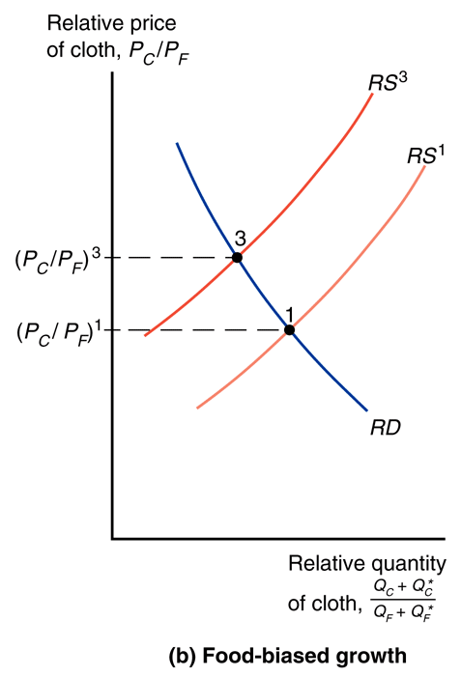
Standard Trade: economic growth
Biased growth changes the growing country’s RS, but more importantly biased growth also affects world relative supply (it is a sum).
It is world relative supply that sets the terms of trade.
Fig. 6-7: Growth and World Relative Supply

Slide 32
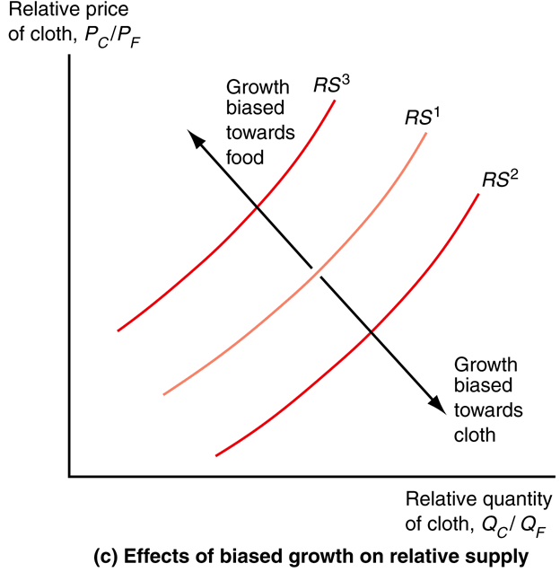
Standard Trade: economic growth
Biased growth and the resulting change in world relative supply changes the terms of trade.
Biased growth in cloth will lower P_{C}/P_{F} and lower the terms of trade for cloth exporters.
Biased growth in food will raise P_{C}/P_{F} and raise the terms of trade for cloth exporters.
Fig. 6-6: Biased Growth

Slide 33
Standard Trade: economic growth
Export-biased growth reduces
a country’s terms of trade, reducing its welfare & increasing the welfare of foreign countries.
Import-biased growth increases
a country’s terms of trade, increasing its welfare & decreasing the welfare of foreign countries.
Fig. 6-6: Biased Growth

Slide 34
Standard Trade: economic growth
immiserizing growth –
export biased growth worsens terms of trade so much that country would be better off if it hadn’t grown at all

Slide 35
Standard Trade: economic growth
Immiserizing growth hasn’t been found in practice.
The gains from increasing productivity invariably overtake the losses from reduced terms of trade.

Slide 36
Standard Trade: economic growth
Even if immiserizing growth existed, note that it wouldn’t mean trade itself is bad.
When terms of trade are reduced a country loses some of the gains from trade, but a country will never be better
off in autarky than trading.

Slide 37
Standard Trade: economic growth
The standard trade model predicts that import-biased growth in China reduces the U.S. terms of trade and the standard of living in the U.S.
(Import-biased growth for China would occur in sectors that
compete with U.S. exports.)

Slide 38
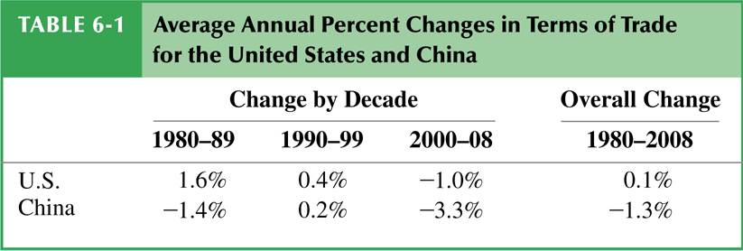
Standard Trade: economic growth
This prediction is not supported by data.
There should be negative changes in the terms of trade for the U.S. and other high-income countries.
But changes in terms of trade were positive for high-income countries and negative for developing countries.

Slide 39
Standard Trade: tariffs & subsidies
import tariff –
tax levied on imports
export subsidy –
payments given to domestic producers that export
Both policies influence the terms of trade and therefore national welfare.

Slide 40
Standard Trade: tariffs & subsidies
Import tariffs and export subsidies drive a wedge between prices in world markets and prices in domestic markets.
So domestic P_{C}/P_{F} will be
more or less than world P_{C}/P_{F}; producers & consumers will respond accordingly by shifting production & consumption.

Slide 41
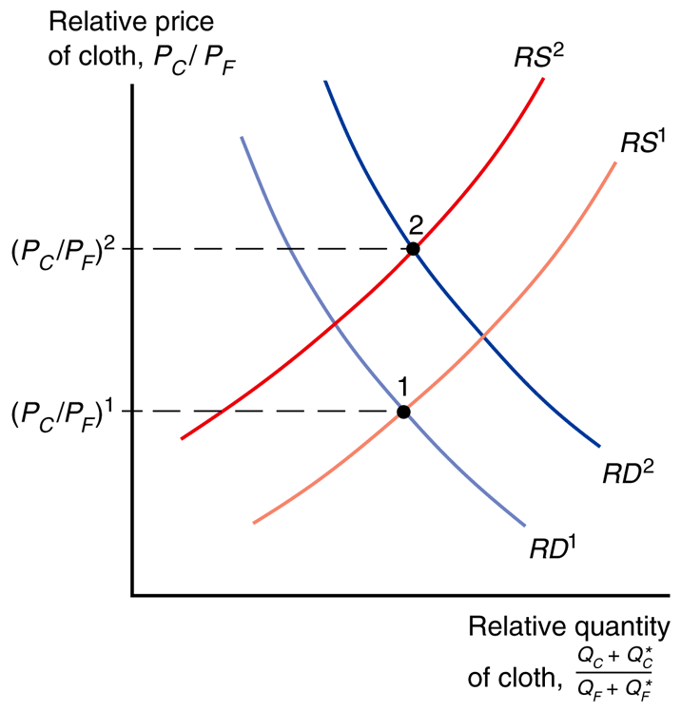
Standard Trade: tariffs & subsidies
If the home country imposes a tariff on food imports, P_{C}/P_{F} falls for domestic consumers/producers.
Domestic producers will produce less cloth and more food.
RS^{W} decreases (shifts left).
Domestic consumers will consume more cloth and less food.
RD^{W} increases (shifts right).
Fig. 6-8: Effects of a Food Tariff on the Terms of Trade

Slide 42
Standard Trade: tariffs & subsidies
So if the home country imposes
a tariff on food imports:
Domestic P_{C}/P_{F} falls relative to a constant world P_{C}/P_{F} (price wedge).
RS^{W} decreases (shifts left).
RD^{W} increases (shifts right).
World P_{C}/P_{F} rises due to the shifts in RS^{W}/RD^{W} from domestic changes.
Fig. 6-8: Effects of a Food Tariff on the Terms of Trade

Slide 43
Standard Trade: tariffs & subsidies
Fig. 6-8: Effects of a Food Tariff on the Terms of Trade
When the home country imposes an import tariff, terms of trade rise & home’s welfare may increase.
Magnitude of this effect depends on the size of the home country.
Small: not much effect on RS^{W} & RD^{W} (and thus terms of trade).
Large: may increase welfare at the expense of foreign countries.

Slide 44
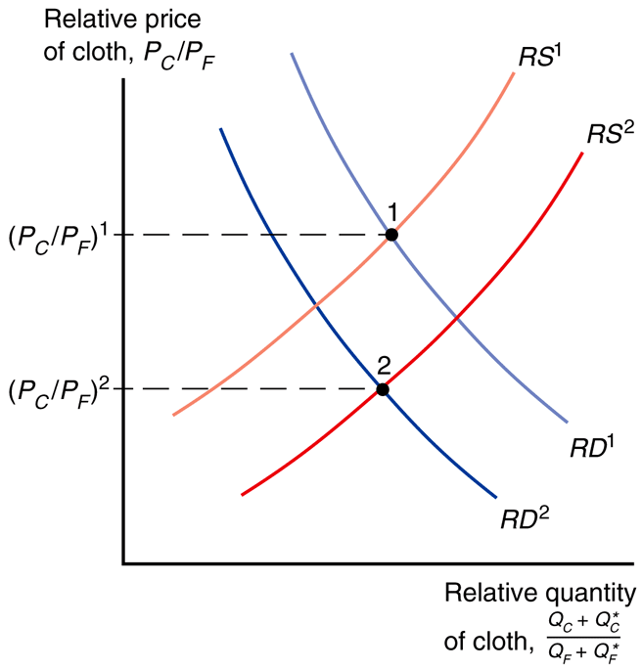
Standard Trade: tariffs & subsidies
If the home country imposes a subsidy on cloth exports, P_{C}/P_{F} rises for domestic consumers/producers.
Domestic producers will produce more cloth and less food.
RS^{W} increases (shifts right).
Domestic consumers will consume less cloth and more food.
RD^{W} decreases (shifts left).
Fig. 6-9: Effects of a Cloth Subsidy on the Terms of Trade

Slide 45
Standard Trade: tariffs & subsidies
So if the home country imposes
a subsidy on cloth exports:
Domestic P_{C}/P_{F} rises relative to a constant world P_{C}/P_{F} (price wedge).
RS^{W} increases (shifts right).
RD^{W} decreases (shifts left).
World P_{C}/P_{F} falls due to the shifts in RS^{W}/RD^{W} from domestic changes.
Fig. 6-9: Effects of a Cloth Subsidy on the Terms of Trade

Slide 46
Standard Trade: tariffs & subsidies
Fig. 6-9: Effects of a Cloth Subsidy on the Terms of Trade
When the home country imposes an export subsidy, terms of trade fall & home’s welfare decreases to the benefit of the foreign country.

Slide 47
Standard Trade: tariffs & subsidies
Export subsidies by foreign on goods the U.S. imports
reduce the world price of U.S. imports
increase the terms of trade for the U.S.
Export subsidies by foreign on goods the U.S. exports
reduce the world price of U.S. exports
decrease the terms of trade for the U.S.

Slide 48
Standard Trade: tariffs & subsidies
Import tariffs by foreign on goods the U.S. exports
reduce the world price of U.S. exports
decrease the terms of trade for the U.S.
Import tariffs by foreign on goods the U.S. imports
reduce the world price of U.S. imports
increase the terms of trade for the U.S.

Slide 49
Standard Trade: tariffs & subsidies
Fig. 6-9: Effects of a Cloth Subsidy on the Terms of Trade
Export subsidies on a good decrease the relative world price of that good by increasing RS of that good and decreasing RD of that good.

Slide 50
Standard Trade: tariffs & subsidies
Fig. 6-8: Effects of a Food Tariff on the Terms of Trade
Import tariffs on a good decrease the relative world price of that good (and increase the relative world price of other goods) by increasing the RS of that good and decreasing the RD of that good.
Note: This seems reversed because here we assume the graph would be P_{F}/P_{C} and (Q_{F} + Q_{F}*)/(Q_{C} + Q_{C}*).

Slide 51
Standard Trade: borrow & lend
Fig. 6-10: Intertemporal Production Possibility Frontier
The standard trade model can be modified to analyze international borrowing and lending.
Two goods are current and future consumption
(the same good at different times, rather than different goods at the same time).

Slide 52
Standard Trade: borrow & lend
Fig. 6-10: Intertemporal Production Possibility Frontier
intertemporal production possibility frontier –
maximum possible mixes of current output & future output
Countries usually have different opportunities to invest.

Slide 53
Standard Trade: borrow & lend
Fig. 6-10: Intertemporal Production Possibility Frontier
Assume home has a PPF biased to current consumption & foreign has a PPF biased to future consumption (foreign has better investment opportunities).

Slide 54
Standard Trade: borrow & lend
Fig. 6-10: Intertemporal Production Possibility Frontier
The price of time is
the real interest rate r.
1 unit of current consumption is worth 1 + r of future consumption
(must repay principal + interest).
1 unit of future consumption is worth 1/(1 + r) units of current.

Slide 55
Standard Trade: borrow & lend
Fig. 6-10: Intertemporal Production Possibility Frontier
Home exports current consumption and imports
future consumption.
Home lends by consuming less than it produces now.
Foreign repays by consuming less than it produces later.

Slide 56
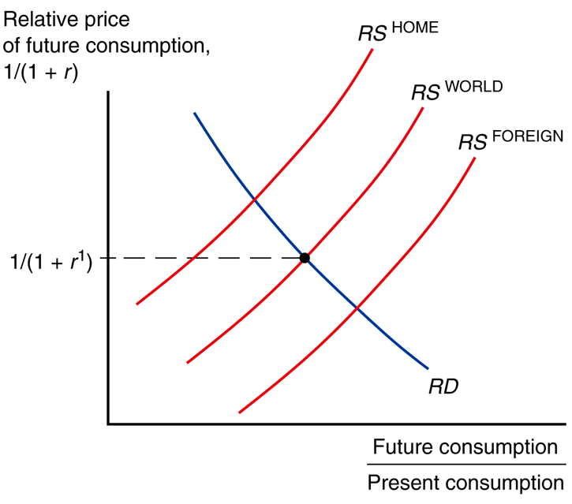
Standard Trade: borrow & lend
Fig. 6-11: Equilibrium Interest Rate with Borrowing and Lending
The relative price of future consumption [1/(1 + r)]
is determined by the
intersection of RS^{W} & RD^{W}.

Slide 57
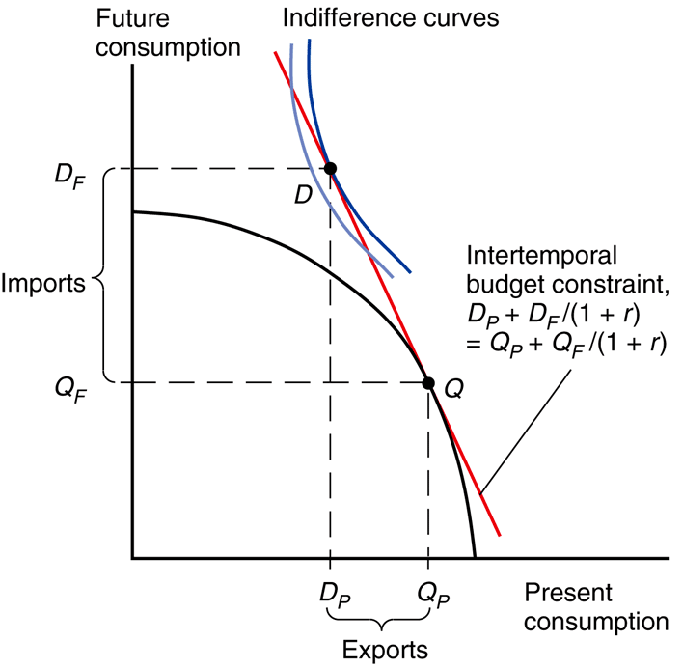
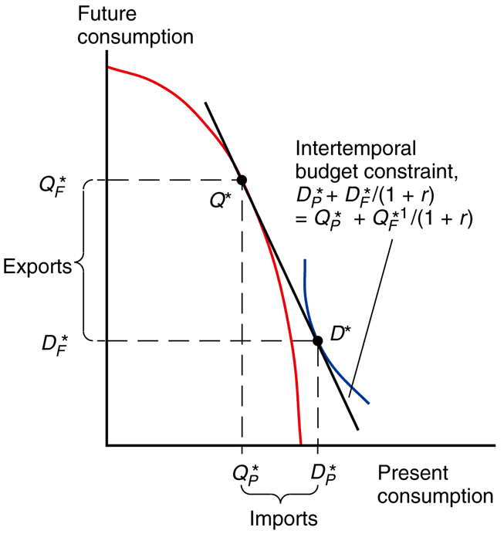
Standard Trade: borrow & lend
Fig. 6A-2: Determining Home’s Intertemporal Consumption Pattern
Fig. 6A-3: Determining Foreign’s Intertemporal Production and Consumption Patterns

